Slide 1
A PROJECT ON WHALING GUARD : PHISHING DETECTION USING MACHINE LEARNING BACHELOR OF TECHNOLOGY IN COMPUTER SCIENCE AND ENGINEERING BY ADITHYAN M S (PRP19CS006)
ASWANI N K (LPRP19CS056)
AMAL SOMAN (PRP19CS012)
HARIKRISHNAN K B (PRP19CS029)
Under the Guidance of
Mrs. KRISHNAPRIYA V J
ACADEMIC BATCH: 2019-2023

Slide 2
CONTENTS
Introduction
Abstract
Literature Survey
Problem Statement
Objectives
Scope
Methodology
System Requirements
System Implementation
Results and Discussion
Conclusion
References

Slide 3
Introduction
Phishing attack is a simplest way to obtain sensitive information from innocent users.
Cyber security persons are now looking for trustworthy and steady detection techniques for phishing websites.
Phishing detection is a crucial aspect of cybersecurity aimed at identifying and preventing phishing attacks.
The objective of this paper is to extract different features from a large dataset containing URLs and to analyse the accuracy levels for different machine learning algorithms and implementing the best among them.
Notes:
1) Aim of the phishers is to acquire critical information like username, password and bank account details.
2) Phishing detection involves the use of sophisticated algorithms, machine learning models, and behavioral analysis to identify patterns and indicators that differentiate legitimate communications from phishing attempts.
3) 15 different machine learning models are compared.

Slide 4
Abstract
In this paper, we have done preprocessing on 2 datasets containing URLs and they are merged to form a new output dataset. Feature extraction is done on this new dataset and have extracted 74 features.
After comparing 15 different machine learning models with the extracted features, we have found that Logistic Regression(LR) model provides the highest accuracy.
The trained LR model is then integrated into our Web Application for predicting whether the input URL from the user interface is phishing or non-phishing.

Slide 5
Literature Survey
Year | Title | Author | Methodology | Conclusion/Results
2020 | PhishHaven—An Efficient Real-Time AI Phishing URLs Detection System | Maria Sameen; Kyunghyun Han; Seong Oun Hwang | Design a PhishHaven which detects and classifies a URL using three subcomponents. First subcomponent, URL Hit The second subcomponent is Features Extractor. The third subcomponent is Modelics, | In this new paradigm executes ensemble-based machine learning models in parallel using multi-threading technique, and results in real-time detection by significant speed-up in the classification process.
2021 | Sufficiency of Ensemble Machine Learning Methods for Phishing Websites Detection | Yi Wei; Yuji Sekiya | Phishing instances are usually derived from PhishTank Other legitimate instances are from Alexa, DMOZ, and Common Crawl. Features used in phishing detection are usually extracted from URLs (protocol, domain, path, parameters) | This feature selection framework achieves a remarkable 87.6% reduction in feature quantity with suffering from only a 0.1% deterioration in detecting accuracy, making it possible for up-date training and real-time detecting in a production environment.
2021 | Eth-PSD: A Machine Learning-Based Phishing Scam Detection Approach in Ethereum | Arkan Hammoodi Hasan Kabla; Mohammed Anbar; Selvakumar Manickam; Shankar Karupayah | Detect phishing scam-related transactions using a novel machine learning-based approach. Eth-PSD tackles some of the limitations in the existing works, such as the use of imbalanced datasets, complex feature engineering, and lower detection accuracy. | Proposed Eth-PSD to detect the phishing scam in Ethereum. Started with derived requirements based on the limitations of related works and other effective IDSs from previous related works.
Notes:
These are the papers referred for our project…..

Slide 6
Year | Title | Author | Methodology | Conclusion/Results
2019 | OFS-NN: An Effective Phishing Websites Detection Model Based on Optimal Feature Selection and Neural Network | Erzhou Zhu; Yuyang Chen; Chengcheng Ye; Xuejun Li; Feng Liu | In the proposed OFS-NN, a new index, feature validity value (FVV), is first introduced to evaluate the impact of sensitive features on the phishing websites detection. Then, based on the new FVV index, an algorithm is designed to select the optimal features from the phishing websites. | This algorithm could properly deal with problems of big number of phishing sensitive features and the continuous changes of features. Consequently, it can mitigate the over-fitting problem of the neural network classifier.
2020 | Comparison of Classification Algorithms for Detection of Phishing Websites | Paulius Vaitkevicius | Compare classic supervised machine learning algorithms on all publicly available phishing datasets with predefined features and to distinguish the best performing algorithm for solving the problem of phishing websites detection, regardless of a specific dataset design. | The comparison results are presented in this paper, showing ensembles and neural networks outperforming other classical algorithms.
2020 | Phishing Detection using Random Forest, SVM and Neural Network with Backpropagation | Sindhu, Sunil Parameshwar Patil,Arya Sreevalsan, Faiz Rahman | The paper explains the improved Random Forest classification method, SVM classification algorithm and Neural Network with backpropagation classification methods which have been implemented with accuracies of 97.369%, 97.451% and 97.259% respectively. | This paper explains the existing machine learning methods that are used to detect phishing websites.
2014 | Intelligent rule-based phishing websites classification | Rami M. Mohammad,Fadi Thabtah,Lee McLusky | The authors shed light on the important features that distinguish phishing websites from legitimate ones and assess how good rule-based data mining classification techniques are in predicting phishing websites and which classification technique is proven to be more reliable. | These features extracted automatically without any intervention from the users using computerised developed tools.

Slide 7
Year | Title | Author | Methodology | Conclusion/Results
2016 | Phishing sites detection based on Url Correlation | Ying Xue, Yang Li,Yuangang Yao, Xianghui Zhao, Jianyi Liu,Ru Zhang | proposed Vulnerable Sites List and a new feature which is named URL Correlation. URL Correlation is based on the similarity of URLs with the List above that we created. | a large improvement of accuracy is observed by comparing methods which use our new feature with the others which use the normal one.
2022 | Characteristics of Understanding URLs and Domain Names Features: The Detection of Phishing Websites With Machine Learning Methods | Ilker Kara; Murathan Ok; Ahmet Ozaday | The proposed method simplifies the process of feature extraction, and reduces processing overhead while going beyond analyzing on HTML, DOM, and URL based features by considering URLs, and domain names. | A minimum loss in data conversion, selecting the appropriate machine learning technique, and consistency of definitions in the data set.
2018 | Detecting phishing websites using machine learning technique | Ashit Kumar Dutta, Zhihan Lv | The proposed framework employs RNN—LSTM to identify the properties Pm and Pl in an order to declare an URL as malicious or legitimate. | The proposed method (LURL) is developed in Python 3.0 with the support of Sci—Kit Learn and NUMPY packages. Also, the existing URL detectors are constructed for evaluating the performance of LURL. LURL has produced an average of 97.4% and 96.8% for Phishtank and Crawler datasets respectively.
2022 | Web Phishing Detection Using Machine Learning | N Kumaran, Purandhar Sri Sai, Lokesh Manikanta | Data Collection Data Pre-Processing Feature Extraction Evaluation Model | Machine learning methods were imported using the Scikit-learn library. Each classification is performed using a training set, and the performance of the classifiers is evaluated using a testing set. The accuracy score of classifiers was calculated to assess their performance.

Slide 8
Year | Title | Author | Methodology | Conclusion/Results
2021 | Detection of Phishing Websites using Machine Learning | Atharva Deshpande, Omkar Pedamkar, Nachiket Chaudhary | Collect unstructured data of URLs from Phishtank website, Kaggle website and Alexa website, etc. Train the three unique classifiers and analyse their presentation based on exactness two classifiers utilized are Decision Tree and Random Forest algorithm. | Scikit-learn tool has been used to import Machine learning algorithms. Each classifier is trained using training set and testing set is used to evaluate performance of classifiers. Performance of classifiers has been evaluated by calculating classifiers accuracy score. improve the accuracy of our models with better feature extraction.
2018 | A New Method for Detection of Phishing Websites: URL Detection | Shraddha Parekh, Dhwanil Parikh , Srushti Kotak , Prof. Smita Sankhe | Random forest algorithm is implemented using Rstudio. The parsed dataset undergoes heuristic classification where the dataset is spilt into 70% and 30%. The 70% data is considered for training and 30% for testing. | In this paper, a different methodology has been proposed to detect phishing websites by using random forests as the classification algorithm with the help of Rstudio.
2018 | Detection of URL based Phishing attacks Using Machine Learning | Ms. Sophiya Shikalgar , Dr. S. D. Sawarkar , Mrs. Swati Narwane | Hybrid Algorithm Approach is a mixture of different classifiers working together which gives good prediction rate and improves the accuracy of the system. | This system provides us with 85.5 % of accuracy for XG Boost Classifier, 86.3% accuracy for SVM Classifier, 80.2 % accuracy for NaÃ¯ve Bayes Classifier and finally 85.6 percentage of accuracy when using Stacking Classifier.
2010 | Large-Scale Automatic Classification of Phishing Pages | Collin Whittaker,Brian Ryner,Maria Nasif | We describe the design and performance characteristics of a scalable machine learning classifier we developed to detect phishing websites. We use this classifier to maintain Googles phishing blacklist automatically. | Despite the noise in the training data, our classifier learns a robust model for identifying phishing pages which correctly classifies more than 90% of phishing pages several weeks after training concludes.

Slide 9
Problem Statement
Phishing has a list of negative effects on a Business, including loss of money, loss of intellectual property, damage to reputation, and disruption of operational activities.
According to the FBI, phishing incidents nearly doubled in frequency, from 114,702 incidents in 2019, to 241,324 incidents in 2020.
Therefore, we suggest a phishing detection model based on machine learning that compares the features of the target websites mainly the URLs
Notes:
The personal data is one of the most important thing than any other.
The development of the phishing detection model is essential to combat the increasing threat of phishing attacks, protect users from fraud and data breaches, and enhance overall cybersecurity in the digital landscape.

Slide 10
Objectives
To extract features that can produce effective accuracy in model evaluation
To analyze the accuracy level for different machine learning algorithms and implementing the best among them
To design and Implement a Web Application to search and detect whether it is phishing or not.
To store URLs, which are detected as either phishing or non-phishing

Slide 11
Scope
Algorithm will analyze various blacklisted and legitimate URL features to accurately detect the phishing websites including zero-hour phishing websites.
A total of 5,45,895 samples are used as dataset.
And 74 different features are extracted from this large dataset for evaluating the model

Slide 12
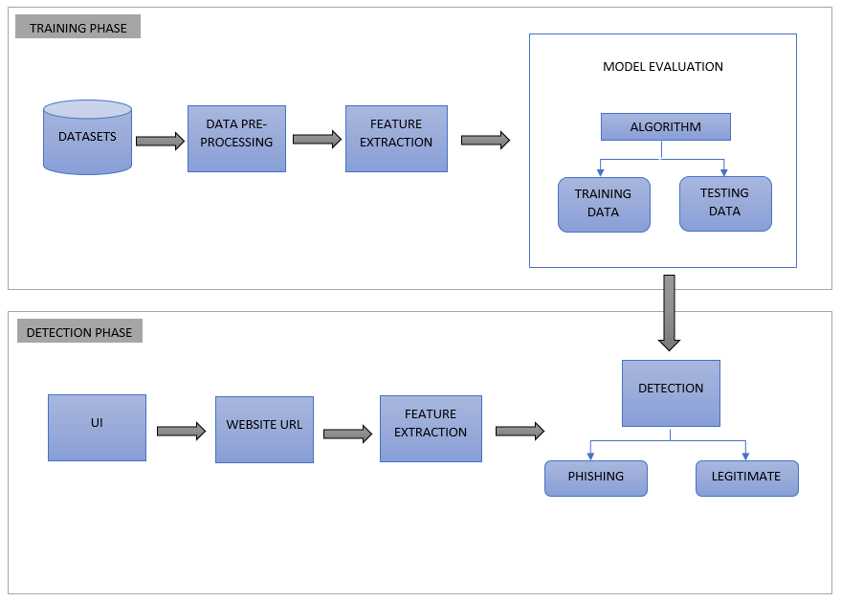
Methodology
System Architecture Design :
2 PHASES :
Training Phase
Detection Phase
Notes:
This is our system architecture……………….., it consist of 2 main phases. Training and Detection Phase:)
In the training phase.., we will be preprocessing the collected datasets and then different features are extracted for the resultant datasets(generated after preprocessing)…, then the new dataset containing the features is split into training and testing datas and using this datas the model is evaluated using the appropriate machine learning algorithm.
And In the detection phase…, the website URL (which is the user Input) , is received from the user using our User Interface . Then the features are extracted for the input string(URL), Based on the model evaluated at the training phase, we will be predicting this extracted features of input URL…. And then lastly we could determine whether the url is phishing or Non-phishing

Slide 13
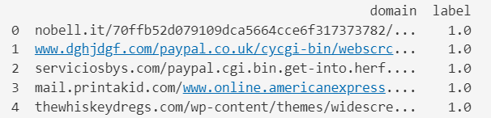
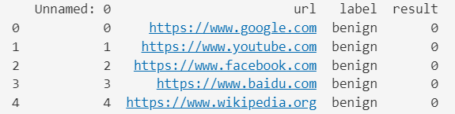
TRAINING PHASE
Datasets:
Dataset-I : from phishtank.com, contains 96,020 data, columns- domain & label
Dataset –II : from Kaggle.com, contains 450,176 data, columns – Unnamed, urls, label & result
Data pre-processing:
Data Cleaning
Data Reduction
Data Integration
Notes:
In the training phase , first is the Dataset…
We are initially using 2 different datasets containing url datas…
Dataset – I =>
it is collected from phishtank.com, It contains 96020 datas. It contains the columns… domain and label. It consist of 50% phishing and 50% non-phishing urls
Dataset – II =>
it is collected from Kaggle.com, It contains 450176 datas. It contains the columns… urls, label and result. This additional dataset is used to improve our model upon deployment
Data Preprocessing…
Data pre-processing is an essential step in preparing raw data for feature extraction
The preprocessing steps involved in our projects are : Data Cleaning, Data Reduction, Data Integration.

Slide 14
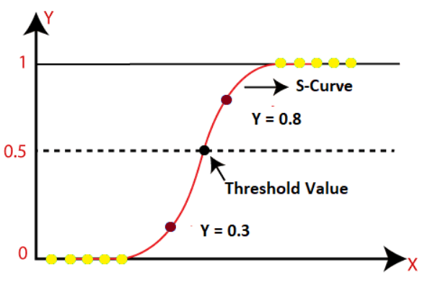
Feature Extraction:
Lexical Features
Numerical Features
Model Evaluation:
Logistic Regression Algorithm
DETECTION PHASE
User Interface:
React Web Application
Nodejs API server
Website URL: Input URL
Detection:
Phishing
Non-Phishing
Notes:
Feature Extraction….
Feature extraction is a technique used to reduce the dimensionality of data by transforming the raw input into a set of derived features that capture the essential information. It aims to highlight the most relevant aspects of the data and discard irrelevant or redundant information.
In our Project , the features are generally classified into two…. Lexiacal and Numerical Features
Model Evaluation…
Logistic Regression Algorithm is used to evaluate our model…
Logistic Regression: it is a classification algorithm, It is based on the assumption that the relationship between the input variables and the log- odds of the binary outcome. And there is threshold value, so the goal is to predict the probability of an event or the likelihood of an outcome falling into one of two classes. can be approximated by a linear relationship.
Next phase Is the detection…
User Interface….
The UI of the application is developed using Reactjs and the API setup for the application is implemented using Nodejs.
Website URL…
This is the input URL from the user to predict whether it is phishing or not
Detection…..
Phishing: Type of URLs that are specifically designed to deceive users by impersonating legitimate websites or services
Non-Phishing: Type of URLs that are the genuine URLs of legitimate websites or services.

Slide 15
System Requirements
Software Requirements
Programming Languages: Python, JavaScript
Integrated Development Environment (IDE): VisualStudioCode, Google-Colab
Libraries: numpy, panda, scikit-learn, Matplotlib/Seaborn, pycaret, pickle, React
Frameworks: Express.js
Web Browsers: Google Chrome, Mozilla Firefox, Microsoft Edge
Package Managers: pip, npm
Version Control: Git, Github
Hardware Requirements
Processor: Intel i5 and above
RAM: 8gb and above

Slide 16
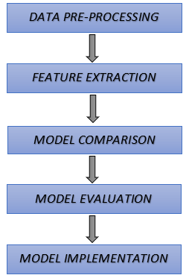
Implementation
System Implementation is divided into 5:
Data Pre-processing
Feature Extraction
Model Comparison
Model Evaluation
Model Implementation
Data Pre-processing
Inputs: Dataset I and Dataset II
Data Cleaning
Dropping Null Values
Data Reduction
Dropping Unwanted Columns
Notes:
The System implementation is divided into five parts…. Data preprocessing,feature extraction, model comparison, model evaluation, model implementation:)
Data PreProcessing….
Dropping Null Values => In both the datasets, we can see that there were certain URLs without label i.e, having null values. We will simply drop these rows.
Dropping Unwanted Columns => Dataset- II, which is the additional_urls, contains unwanted columns.. Like results, We will be also dropping these columns.

Slide 17
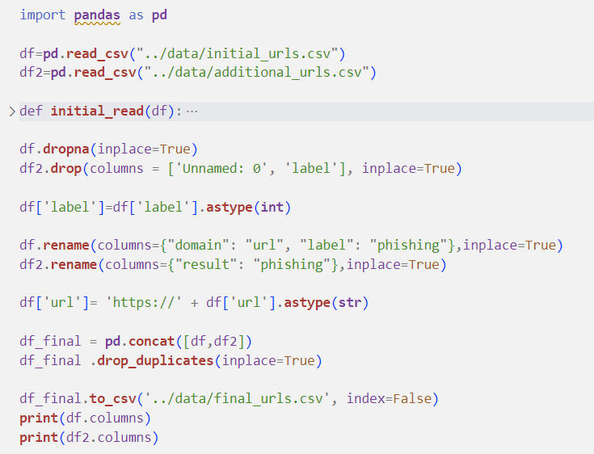
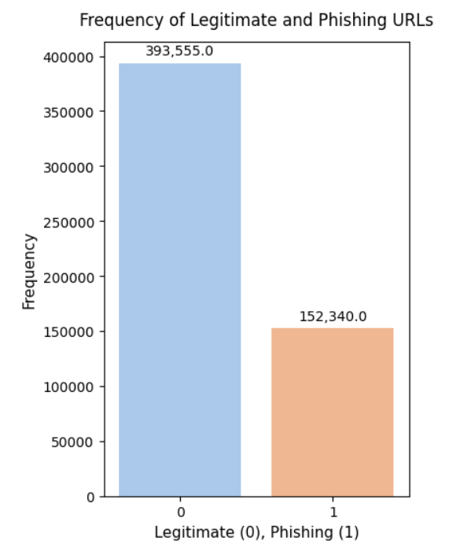
Data Integration
Changing Data Types
Changing Column names
Merging the 2 Datasets
Removing Duplicates
Output: New Dataset after pre-processing
Notes:
Changing Data Types => Merging DataFrames with different data types for the same column name might lead to inconsistencies and unexpected behavior..hence the datatypes are changed.
Changing Column Names => merging DataFrames having different column names produce splitting of the values.(increases the number of columns generated when merging)
Merging the 2 Datasets => After Merging we obtained a dataset having 546,104 datas and saved in a new csv file.
Removing Duplicates => After merging there are chances of having duplicate data inside the resultant dataset. There were 194 Duplicate URLs in our resultant dataset. And these were dropped.

Slide 18
Feature Extraction
Lexical Features
Numerical Features
Input: Dataset generated after pre-processing
Lexical Features
Involve analyzing the textual components and patterns within a URL.
These features capture characteristics related to the structure, keywords, and other textual elements of a URL.
Slno | Lexcial Features | Description
1 | getEntropy | Measuring the entropy of URL strings
2 | hasLogin | Check if the URL contains specific keyword ”login”
3 | Redirection | Check for the presence of redirection in URL string
4 | lenClassify | Check if the length of the URL is greater than or equal to 54 characters
5 | haveAtSign | Checks for the presence of ’@’ symbol in the URL
6 | getDepth | Calculate the number of subpages in the given URL
7 | tinyURL | Check if the URL is URL shortened
8 | isDomainIp | Check if there is IP address instead of hostname
9 | prefixSufix | Check the presence of ’-’ in the domain of URL
Notes:
2. Feature Extraction….
In this project the extracted features classified into to 2---Lexical and Numerical features.
getEntropy => Non-phishing URLs have higher entropy and are generally longer than phishing
hasLogin => we can capture the fact that certain ‘red flag’ keywords like.. “login” appear in a URL string. Attackers use these keywords when trying to spoof a non-phishing page or keywords that relate to popular nomenclature of security settings on a website that a hacker will try to manipulate.
Redirection => Phishing attackers often employ redirection techniques to hide the true destination of a malicious URL and they can make it more difficult for users and security systems to identify the final destination.
lenClassify => Phishers can use long URL to hide the doubtful part in the address bar.
haveAtSign => while using “@” symbol in the URL, it leads the browser to ignore everything preceding the “@” symbol and the real address can thus be ignored.( often follows the “@” symbol).And also used to mimic or spoof well-known websites or services.
getDepth => It represents how nested a specific resource is within a website’s directory structure.
tinyURL => URL shortening is a method in which a URL are shortened and can still lead to the required webpage. And this is accomplished by most of the phishing websites.
isDomainIp => Some of the phishing urls use Ipaddress instead of hostname for domain name.
prefixSufix = > Phishers tend to add prefixes or suffixes separated by (-) to the domain name so that users feel that they are dealing with a legitimate webpage.

Slide 19
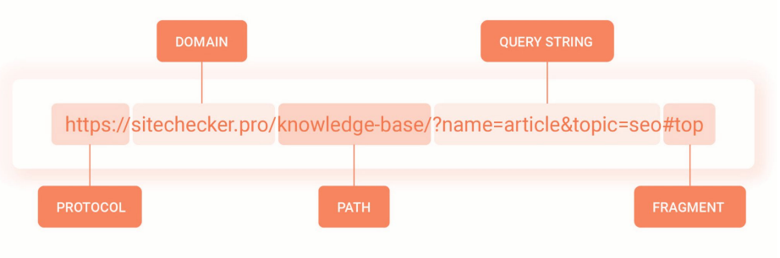
Numerical Features
Features that represent quantitative or continuous values.
These features can take on a wide range of numeric values
URL text features are basically classified into - protocol, domain, path, query, fragment.
The length of this each feature (excluding protocol) and the count of the different special characters in that feature are extracted
The special characters like ‘.’ ‘-’ ‘/’ ‘?’ ‘=’ ‘@’ ‘&’ ‘!’ ‘ ’ ‘˜’ ‘,’ ‘+’ ‘*’ ‘#’ ‘$’ ‘%’ .
Number of features = 65
Finally, a total of 74 features are extracted.
Output: New Dataset with extracted Features

Slide 20
 |  | Numerical Features
url_length | qty_asterisk_url | qty_and_path | qty_questionmark_query | qty_dot_fragment
qty_dot_url | qty_hashtag_url | qty_exclamation_path | qty_equal_query | qty_hyphen_fragment
qty_hyphen_url | qty_dollar_url | qty_space_path | qty_at_query | qty_slash_fragment
qty_slash_url | qty_percent_url | qty_tilde_path | qty_and_query | qty_questionmark_fragment
qty_questionmark_url | domain_length | qty_comma_path | qty_exclamation_query | qty_equal_fragment
qty_equal_url | qty_dot_domain | qty_plus_path | qty_space_query | qty_and_fragment
qty_at_url_ | qty_hyphen_domain | qty_asterisk_path | qty_tilde_query | qty_exclamation_fragment
qty_and_url | path_length | qty_dollar_path | qty_comma_query | qty_space_fragment
qty_exclamation_url | qty_dot_path | qty_percent_path | qty_plus_query | qty_comma_fragment
qty_space_url | qty_hyphen_path | query_length | qty_asterisk_query | qty_asterisk_fragment
qty_tilde_url | qty_slash_path | qty_dot_query | qty_dollar_query | qty_hashtag_fragment
qty_comma_url | qty_equal_path | qty_hyphen_query | qty_percent_query | qty_dollar_fragment
qty_plus_url | qty_at_path | qty_slash_query | fragment_length | qty_percent_fragment

Slide 21
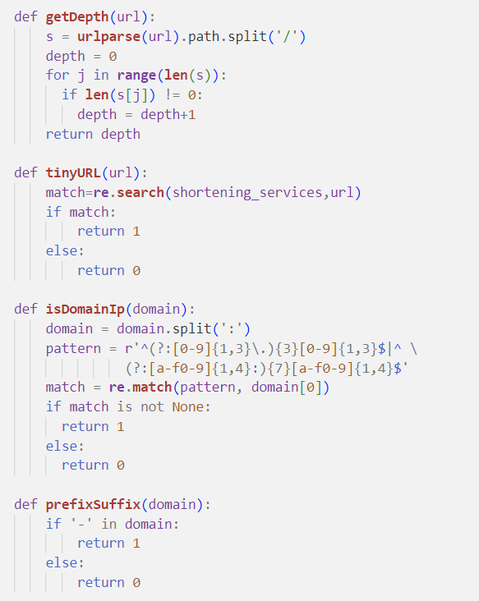
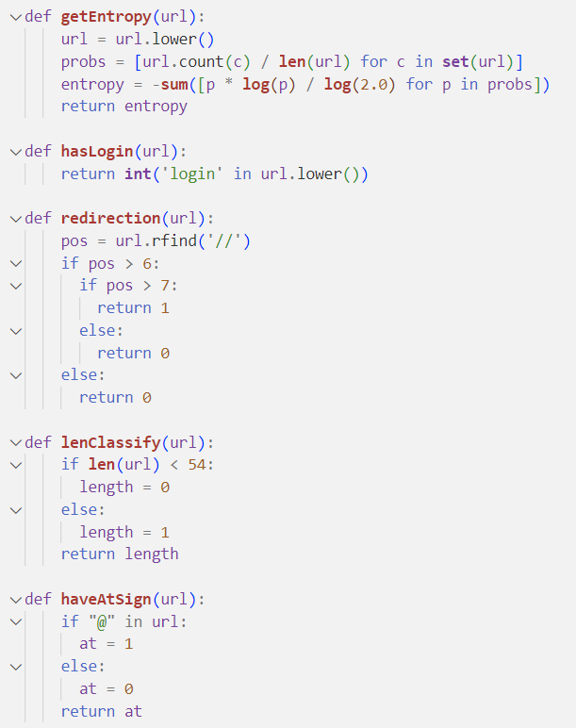
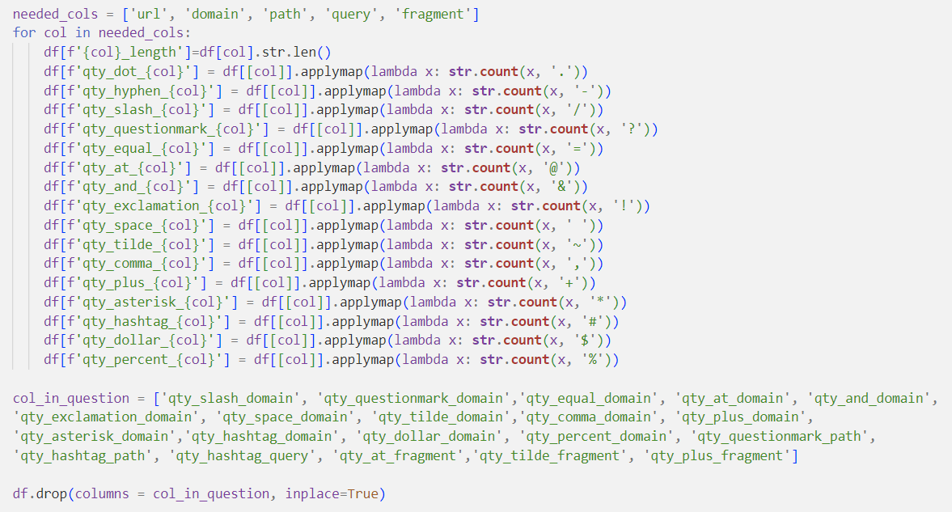
Lexical Feature Extraction
Numerical Feature Extraction

Slide 22
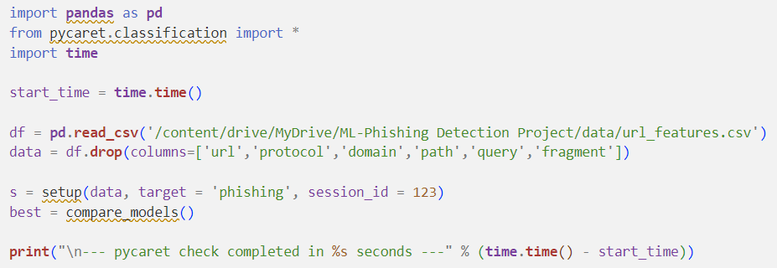
Model Comparison
Pycaret
PyCaret, machine learning library in Python is used to compare 15 different machine learning models.
compare_models() function of pycaret intiates the comparison and returns a table of model performance metrics sorted by a specified evaluation metric.
Result: Logistic Regression shows highest Accuracy
Notes:
3. Model Comparison….
PyCaret is a Python library that provides an easy-to-use interface for training and comparing multiple machine learning models. It offers a variety of functions and tools to streamline the model development process and make it efficient.
The dataset containing the extracted features are used for training using pycaret by 15 different machine learning models
After comparison we have found that LR gave highest accuracy, thus LR is used for model Evaluation.

Slide 23
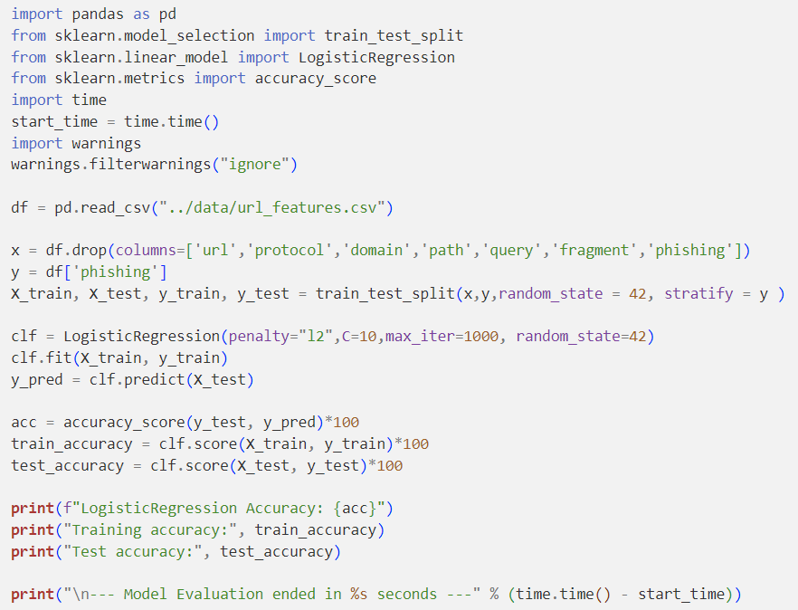
Model Evaluation
Evaluating the LR model includes the following steps:
Splitting the dataset into training and testing sets
Fitting the logistic regression model to the training data
Use the trained model to predict testing set.
Calculating evaluation metrics(accuracy)
Extracted Features
Training
Testing
Notes:
Model Evaluation….
Library used => sklearn
We used train_test_split() function to split the dataset into training and testing data.
Used the fit() function of LogisticRegression to fitting the model to training data
Used the predict() function of LogisticRegression to predict the test data
Based on the prediction result the accuracy levels are calculated.

Slide 24
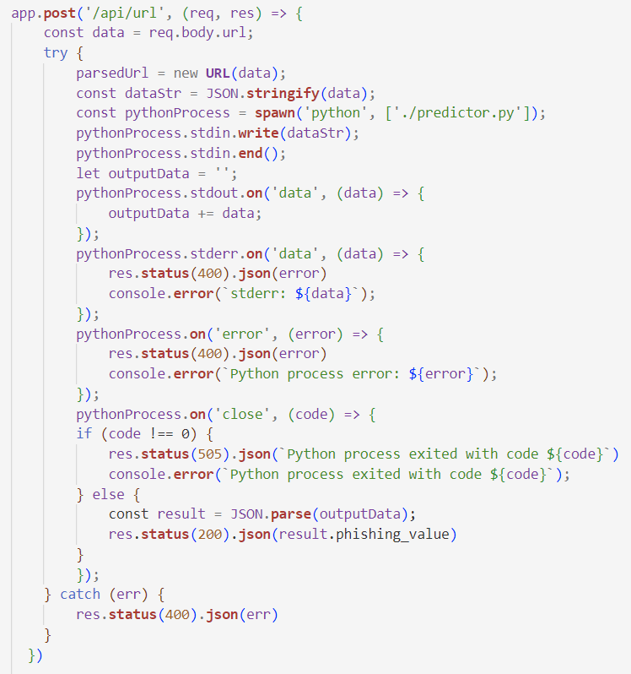
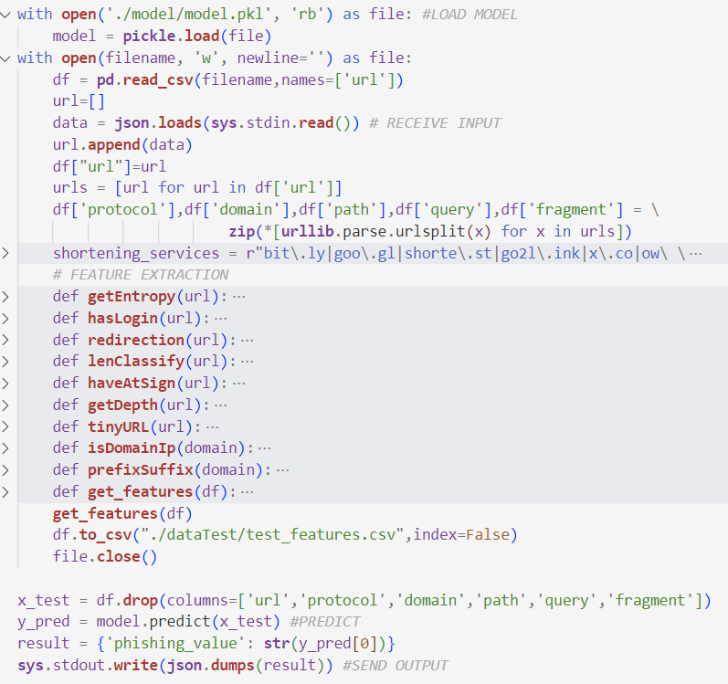
Model Implementation
This include the following processes:
Saving the trained model in a serialized format
Integrating the model into the target Web Application
Get the input URL from the user
Extract the 74 different features from the input URL
Loading the serialized model into the implementation environment
Utilize the loaded model to generate predictions on the extracted features.
Output Delivery : The prediction result is then passed.
api.js
predictor.py
Notes:
We will be using python pickle module for exporting the trained lr model, which is a built-in module that provides a way to serialize and deserialize Python objects.
To use it for predicting the input URL from the user through the web interface.
The input url is reached at the API upon POST request, then the api executes the predictor.py by sending input URL as input to it.
Extracting the 74 features from the input URL
We will be loading the model into the predictor.py again using the pickle module.
We will be predicting extracted features using this loaded model..
The Output is then pass to the API and the result is displayed at the UI as a response.

Slide 25
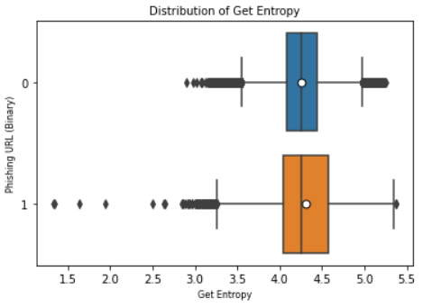
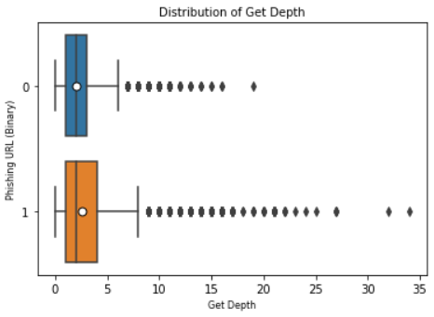
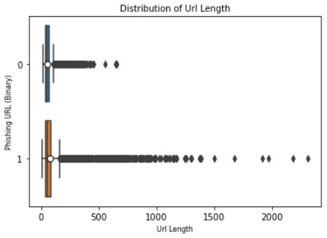
Results and Discussion
Feature Analysis
Boxplot Graph: It is employed to explore and understand the distribution of feature values during the analysis of the dataset and provides insights including measures of central tendency, dispersion, mean and identification of outliers. Visualization of some features are shown below:
Notes:
A. Feature Analysis …..Analyising the extracted features by visualizing them--
The boxplot graph is a useful visualization for displaying the distribution of a numerical feature or variable.
Implemented using Matplotlib and Seaborn libraries of python
Visually, we see that legitimate URLs have higher entropy and are generally longer than phishing URLs.
The depth of the URL i.e., number of hierarchical levels or directories in the URL’s path for phishing URLs is seen greater than the legitimate ones.
It is also seen that the phishing URLs have higher URL length than the legitimate URLs.

Slide 26
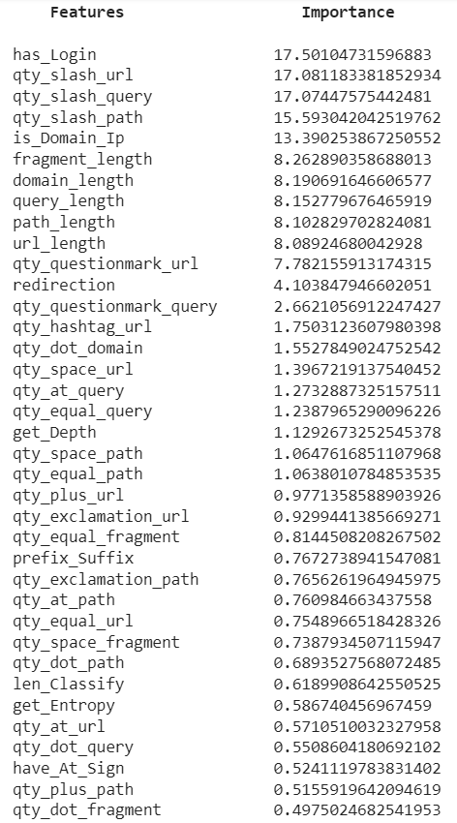
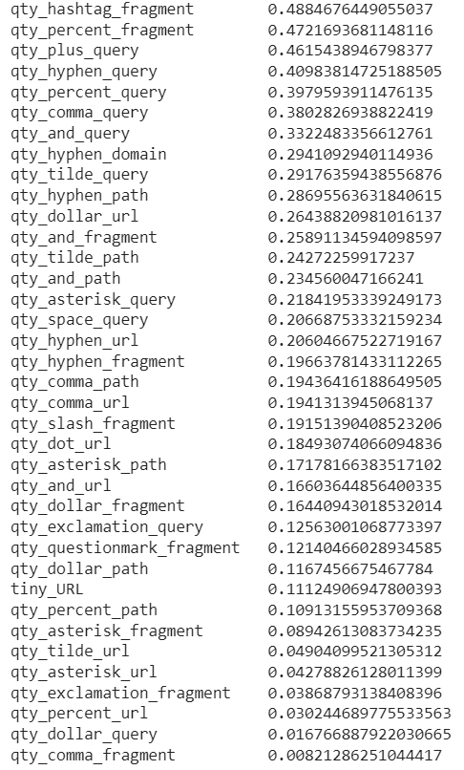
Feature Importance:
Based on the Logistic Regression Model, it has assigned feature importance score to each extracted features.
It helps to provide insights into which features have the most influence on the model’s predictions
Notes:
It helps understand the impact of each feature on the model's predictions.
Here.. All the 74 different Features are represented in the decreasing order of their importance…
And, has_Login has the most importance

Slide 27
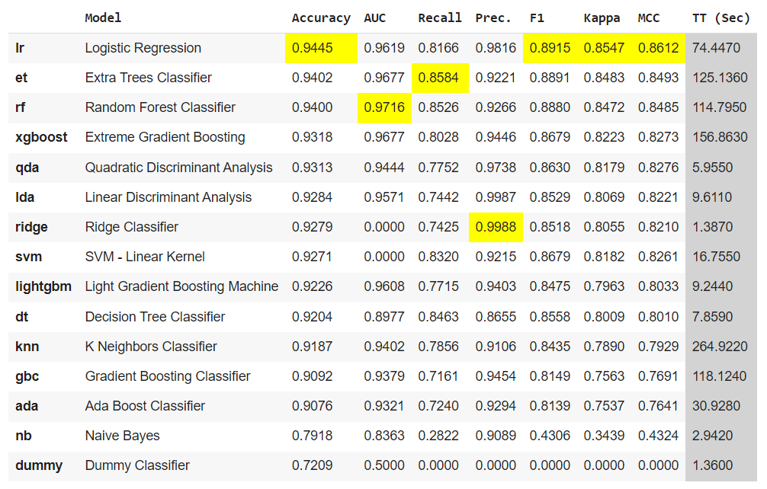
Pycaret Analysis
Comparison results obtained using PyCaret, guide in selecting the most suitable machine learning model(s) for this project, taking into account performance metrics, statistical significance, feature importance, and other relevant factors.Below Fig shows the comparison result.
Notes:
B. Pycaret Analysis…. Anaylizing the model comparison result..
Pycaret have compared 15 different machine learning models and amongst them LR gave higher accuracy
Also as we can see from the table, the TT(Time Taken) for LR is considerably less than others
And Based on theses factors , we have selected LR for model evaluation.

Slide 28
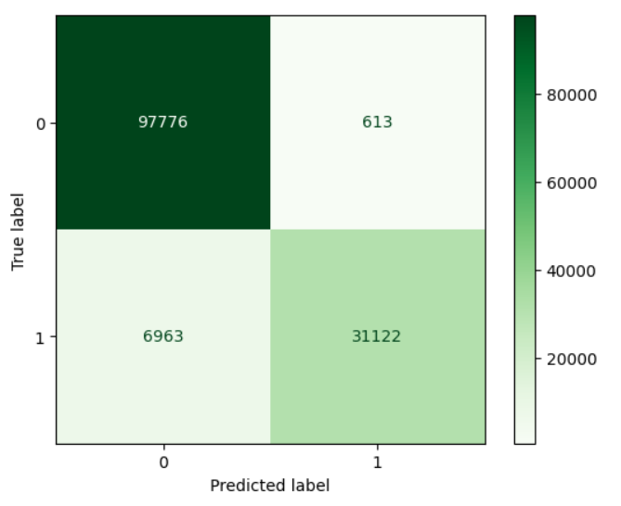
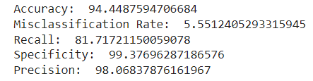
Model Analysis
The confusion matrix provides a more detailed understanding of the model’s performance beyond simple accuracy.
Evaluation Metrics:
TN
FP
FN
TP
Notes:
C. Model Analysis…Analyizing the evaluated model(LR Model)
Confusion matrix is used to analysis the model…
A confusion matrix is a table that is used to evaluate the performance of a classification model.
Implemented using confusion_matrix, ConfusionMatrixDisplay from sklearn.metrics library
It shows the number of true positives (TP), true negatives (TN), false positives (FP), and false negatives (FN) by comparing the predicted labels with the true labels of a dataset
TP=31122, FP =613
TN=97776, FN = 6963
Accuracy = (TP+TN) / (TP+TN+FP+FN)
Precision = TP / (TP+FP)
Recall = TP / (TP+FN)

Slide 29
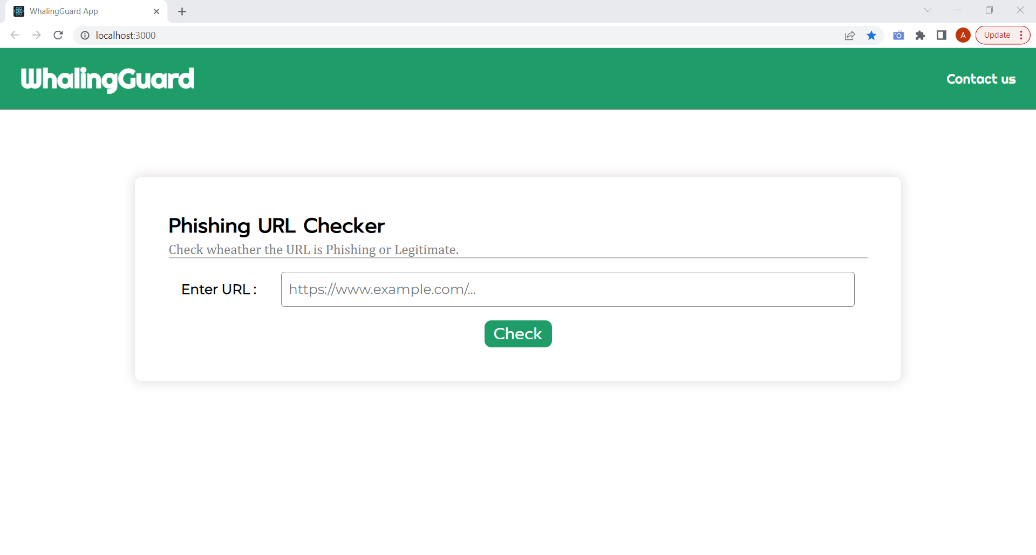
Web Application
We have developed a web application where the users can input URLs to check if it is phishing or non-phishing. UI of the application is developed using Reactjs and the API setup for the application is implemented using Nodejs.
Notes:
User Interface of the WhalingGuard web application.

Slide 30
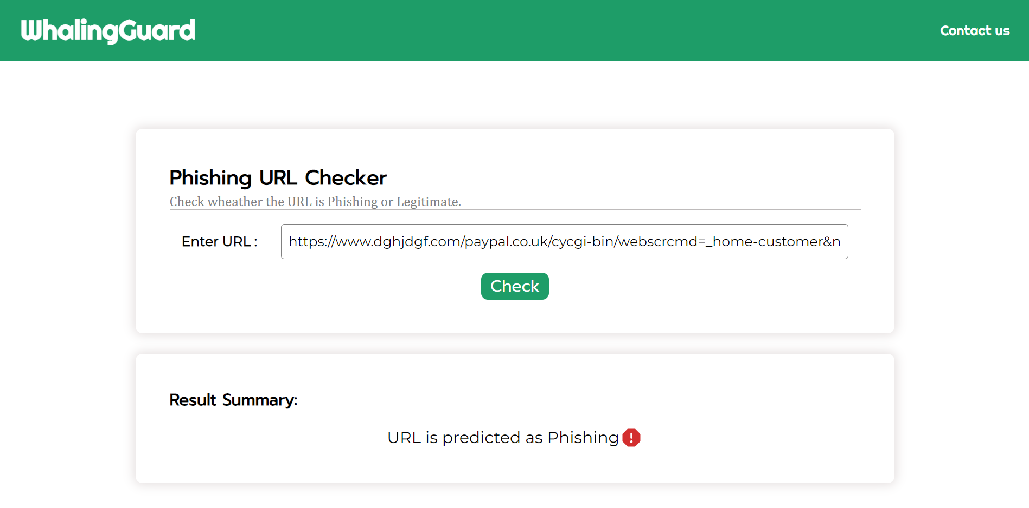
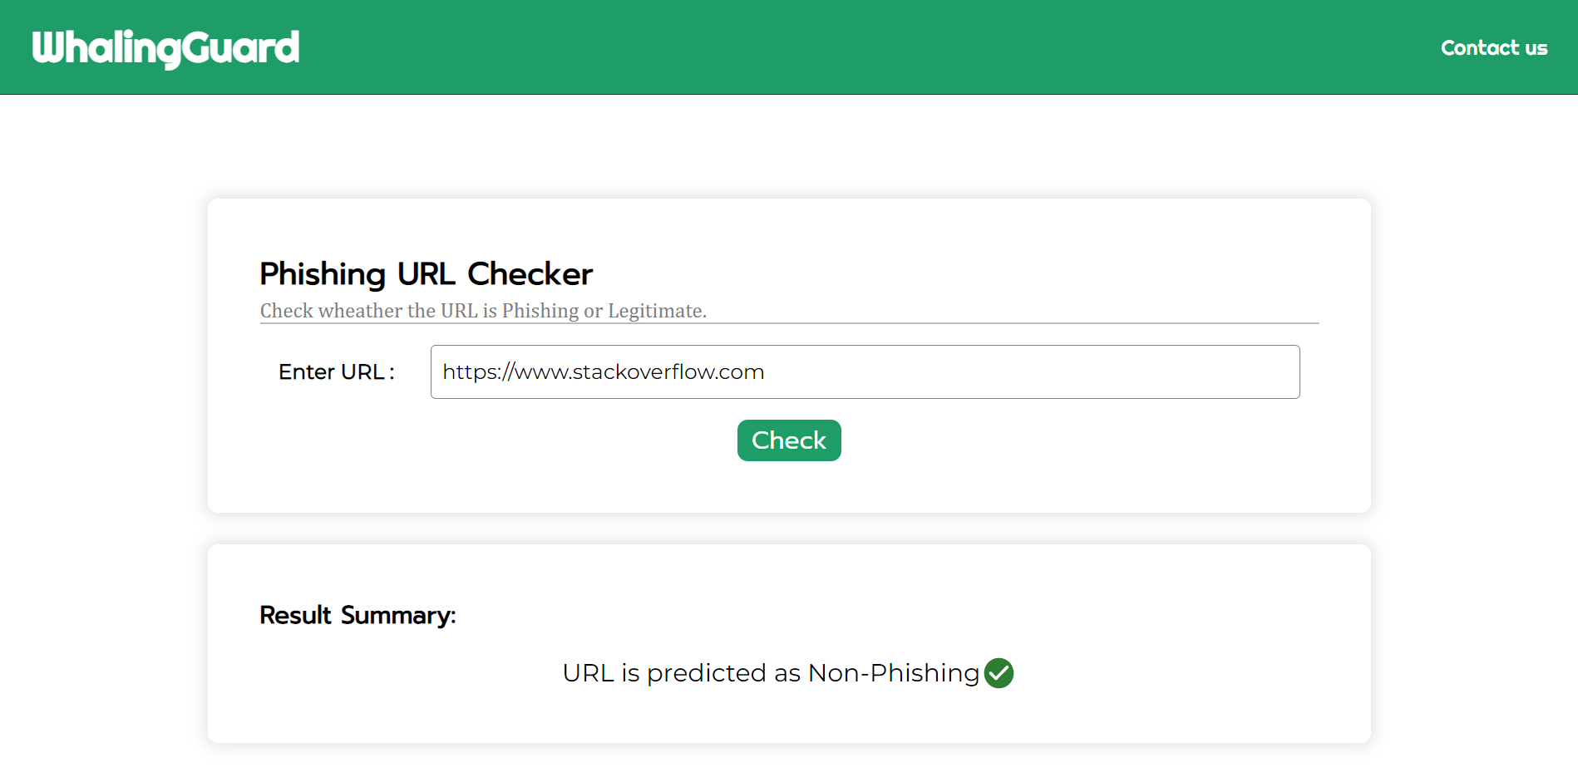
The URL entered by the user is received by the server and it is predicted by the evaluated LR model. Based, on the prediction, the summary of the result is shown as output in the user-interface. The following figures shows the 2 different output produced

Slide 31
Conclusion
In particular, phishing has become more common and has begun to raise significant issues. There needs to design phishing detection method to affectively detect if the website is phishing or non-phishing. Considering the significance of phishing detection, in this study, we extracted 74 different features from the website URL. After comparing different machine learning algorithms, we found that Logistic Regression gives higher accuracy. So, we used Logistic Regression model for phishing prediction. In future we are planning to design a framework for identifying and preventing phishing attacks that are delivered through email messages.

Slide 32
References
[1] ”PhishHaven—An Efficient Real-Time AI Phishing URLs Detection System” ( Maria Sameen, Kyunghyun Han, Seong Oun Hwang [2020])
[2] ”Sufficiency of Ensemble Machine Learning Methods for Phishing Websites Detection” (Yi Wei, Yuji Sekiya. [2021])
[3] ”Eth-PSD: A Machine Learning-Based Phishing Scam Detection Approach in Ethereum” (Arkan Hammoodi Hasan Kabla, Mohammed Anbar, Selvakumar Manickam, Shankar Karupayah . [2021])
[4] ”OFS-NN: An Effective Phishing Websites Detection Model Based on Optimal Feature Selection and Neural Network” (Erzhou Zhu, Yuyang Chen, Chengcheng Ye, Xuejun Li, Feng Liu. [2019])
[5] ”Comparison of Classification Algorithms for Detection of Phishing Websites” (Paulius Vaitkevicius. [2020])
[6] ”Phishing Detection using Random Forest, SVM and Neural Network with Backpropagation” (Sindhu, Sunil Parameshwar Patil, Arya Sreevalsan, Faiz Rahman [2020])
[7] “Intelligent rule-based phishing websites classification” (Rami M. Mohammad, Fadi Thabtah, Lee McLusky. [2014])
[8] ”Phishing sites detection based on Url Correlation” (Ying Xue, Yang Li,Yuangang Yao, Xianghui Zhao, Jianyi Liu,Ru Zhang. [2016])

Slide 33
[9] ”Characteristics of Understanding URLs and Domain Names Features: The Detection of Phishing Websites With Machine Learning Methods” (Ilker Kara, Murathan Ok, Ahmet Ozaday . [2022])
[10] Detecting phishing websites using machine learning technique” (Ashit Kumar Dutta, Zhihan Lv. [2018])
[11] ”Web Phishing Detection Using Machine Learning ” (N Kumaran, Purandhar Sri Sai, Lokesh Manikanta. [2022])
[12] ”Detection of Phishing Websites using Machine Learning” (Atharva Deshpande, Omkar Pedamkar, Nachiket Chaudhary . [2021])
[13] New Method for Detection of Phishing Websites: URL Detection” (Shraddha Parekh, Dhwanil Parikh , Srushti Kotak , Prof. Smita Sankhe. [2018])
[14] ”Detection of URL based Phishing attacks Using Machine Learning” (Ms. Sophiya Shikalgar , Dr. S. D. Sawarkar , Mrs. Swati Narwane. [2018])
[15] ”Large-Scale Automatic Classification of Phishing Pages ” (Collin Whittaker, Brian Ryner, Maria Nasif. [2010])

Slide 34
Project Presented as Conference Paper
International Conference On Intelligent Technologies In Computer And Engineering Science ITCES-2023

Slide 35
Thank You
Notes:
Thank you

